Slide 1

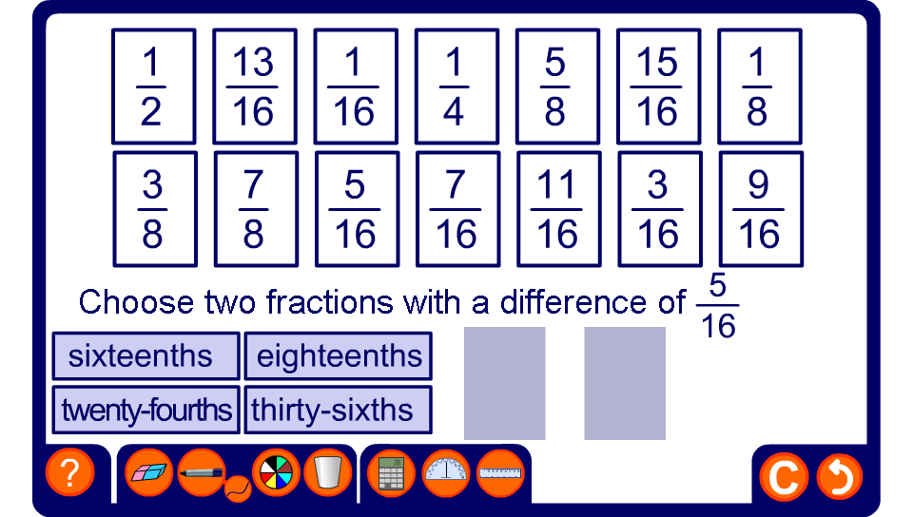


Fraction cards
Notes:
Start by asking pupils for the lowest common denominator of the set of fractions on the board. Go on to establish that every fraction on the board can therefore be expressed as an equivalent fraction over that denominator.
Review the fact that to add or subtract two fractions they must be written over a common denominator.
Ask volunteers to come to the board and show different possible solutions to the sum or difference required.
If required you may drag one of the fraction cards down and ask pupils for the other card to make the required sum or difference.
Ensure, during the course of the activity, that pupils are able to quickly and confidently convert fractions to equivalent fractions over a common denominator (either mentally or using jottings).

